Slide 1
Cartpole balancing system

Slide 2
Introduction
This project aims to train an agent to balance a pole on a cart in the CartPole environment using Deep Q-Learning. The CartPole game involves keeping a pole balanced by moving a cart left or right. The agent learns optimal actions through trial and error, using a Deep Q-Network (DQN) model to approximate the action-value function. By iteratively adjusting its policy based on observed rewards, the agent gradually improves its performance, showcasing the effectiveness of reinforcement learning in mastering complex control tasks like CartPole balancing.

Slide 3
Cartpole results of our code

Slide 4
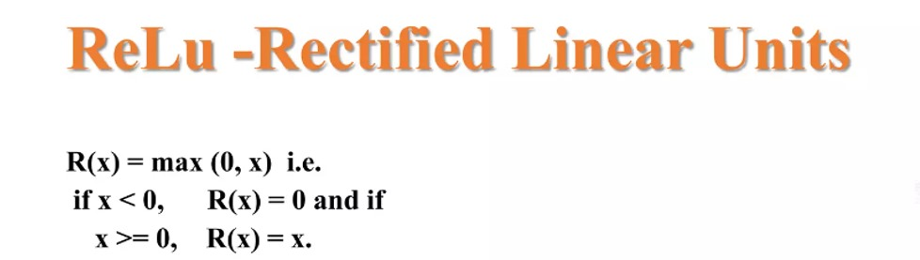
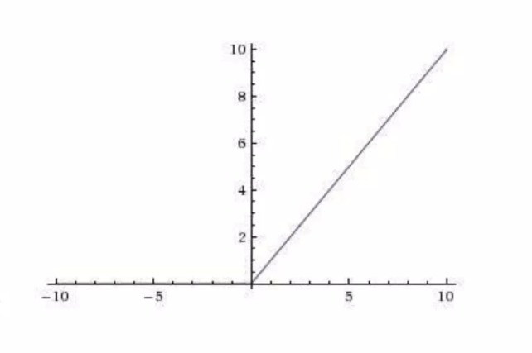
Mathematical formulas involved
ReLU Activation Function: This function is used in the hidden layers of the neural network. It’s defined as:
GRAPH FOR Relu Activation Function:

Slide 5

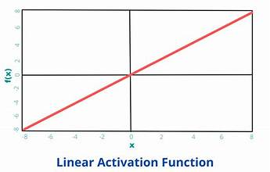
Linear Activation Function: This function is used in the output layer of the neural network. It’s defined as:
Graph For Linear Activation Function:

Slide 6
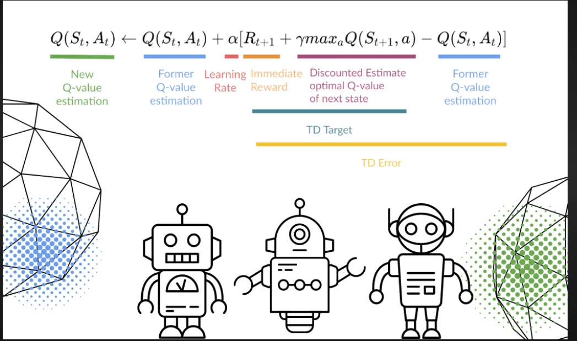
Q-Learning Update Rule: This rule is used to update the Q-values. It’s defined as
where Q(s,a) is the predicted Q-value of taking action a in state s, r is the immediate reward, s′ is the next state, a′ is the action taken in state s′, α is the learning rate, and γ is the discount factor.

Slide 7
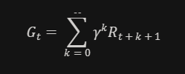

Epsilon-Greedy Policy: This policy is used for action selection. With probability ϵ, a random action is selected, and with probability 1−ϵ, the action with the highest predicted Q-value is selected.
Discounted Future Reward: The total reward that the agent expects to receive in the future is discounted by a factor of γ at each time step. It’s calculated as
where Gt​ is the total discounted reward at time step t, Rt+k+1​ is the reward received at time step t+k+1, and γ is the discount factor.
Epsilon Decay: The value of ϵ decays over time according to the formula

Slide 8
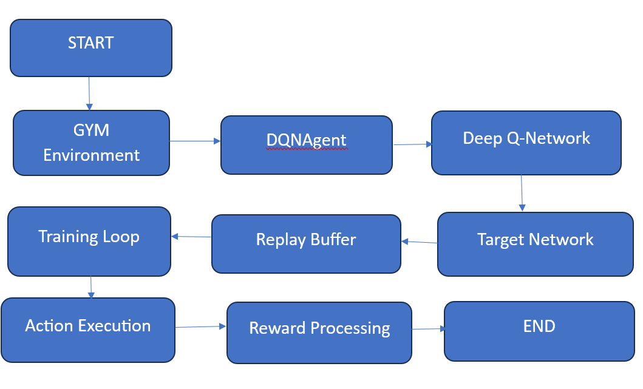
PROPOSED DIAGRAM

Slide 9
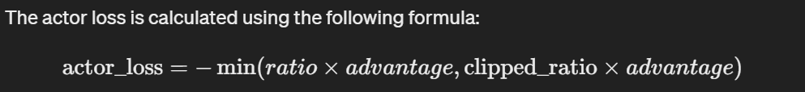
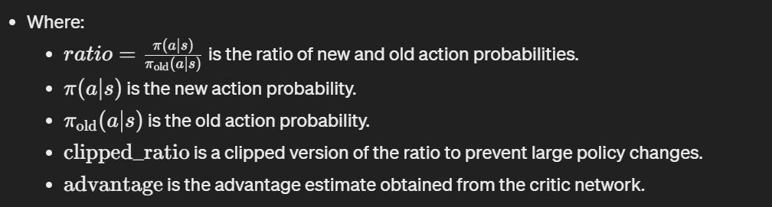
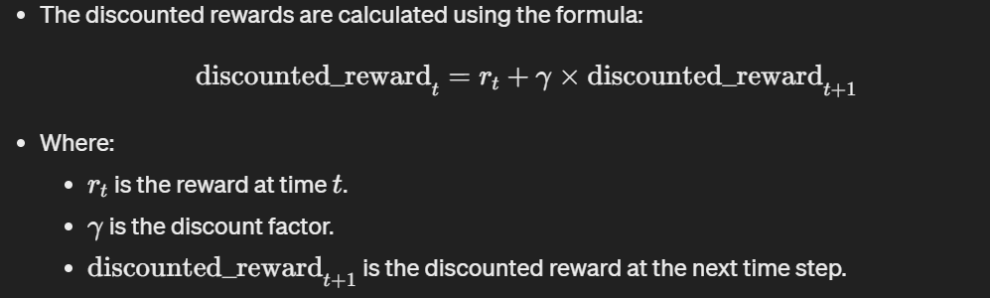
Proximal Policy Optimization
Actor Loss Calculation:
The actor loss is calculated using the following formula:
Discounted Rewards Calculation:

Slide 10
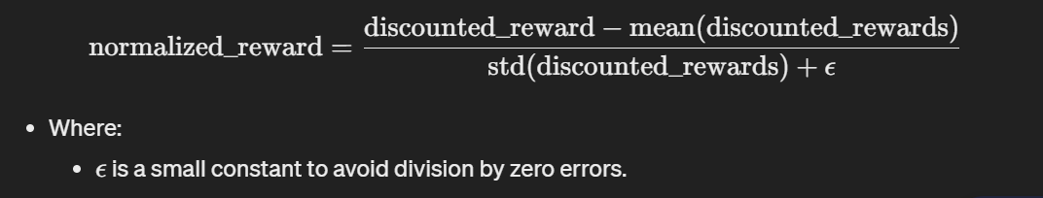
Normalization of Discounted Rewards:

Slide 12
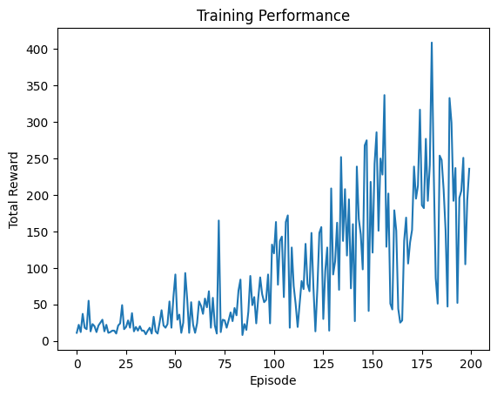
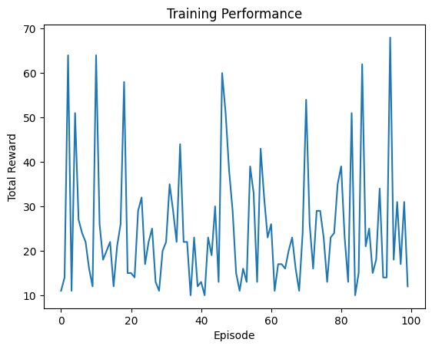
comparison
DQN
PPO
After successfully running the DQN MODEL AND PPO model we can see that the DQN is performing way better than the ppo model , where the DQN model is getting rewards of greater than 100 in 100 epochs and ppo struggled to get highest reward of 70 with in 100 epochs

Slide 13
Literature review
Title: Balancing a Cartpole System with Reinforcement Learning -- A Tutorial
This paper offers a comprehensive exploration of reinforcement learning (RL) algorithms applied to Cart-Pole system control. Detailed descriptions of Q-learning, Deep Q Networks (DQN), Double DQN, Dueling networks, and (prioritized) experience replay are provided, alongside demonstrations of their impact on learning performance. Utilizing OpenAI/Gym and Keras utilities, the study highlights DQN with prioritized experience replay (PER) as the most effective architecture, capable of solving the problem within 150 episodes.

Slide 14
Thank you

